Slide 1

PSYC100 GENERAL PSYCHOLOGY
INTELLIGENCE

Slide 2
Learning outcomes
Defining intelligence
Theories of intelligence
  Two-factor theory of Spearman
  Fluid and Crystallized Intelligence theory of Cattell
  Sternberg’s theory
  Gardner’s theory
Intelligence testing
  Standford-Binet test
  Wechsler tests
  Raven’s progressive matrices
Gender differences in IQ
Racial differences in IQ
The Flynn Effect

Slide 3
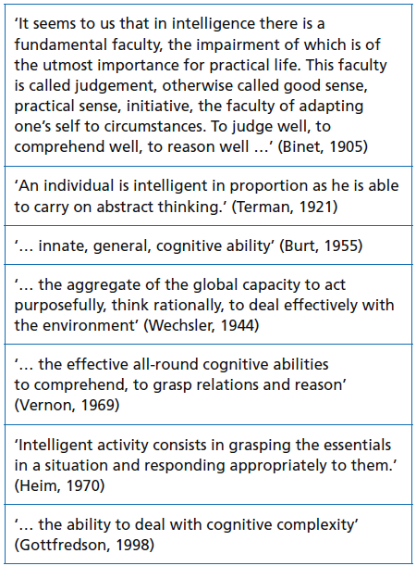
What is intelligence?
HOW WOULD YOU DEFINE INTELLIGENCE?

Slide 4
“A very general mental capability that involves the ability to reason, plan, solve problems, think abstractly, comprehend complex ideas, learn quickly, and learn from experience.”

Slide 5
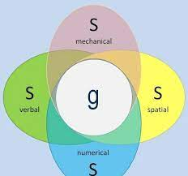
Theories of intelligence
Spearman’s two-factor theory (1904)
  All intellectual activities share a common underlying factor (g), along with specific factors (s) unique to each task. So performance on any mental task depends on how intelligent you are overall (g) plus how skilled you are in that specific area (s).
  There is a single general intelligence (g) that influences performance on every cognitive task.
  There are also many specific abilities (s) unique to each task.

Slide 6
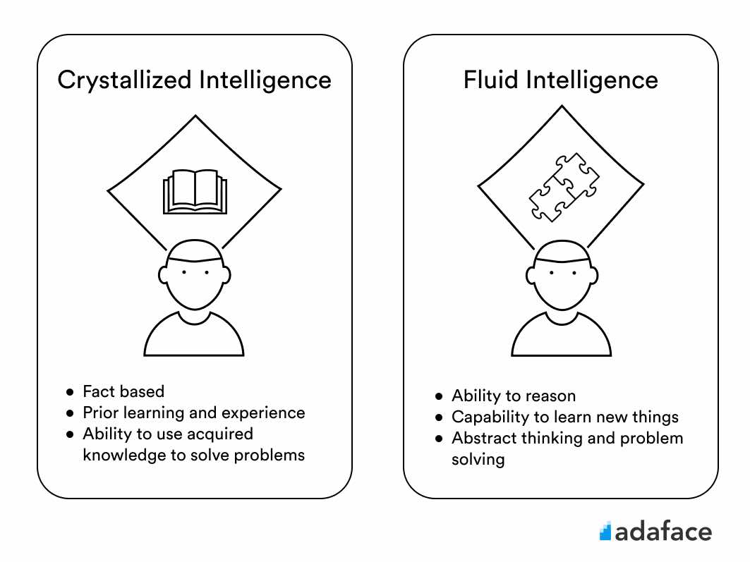
Theories of intelligence (cont.)
  Fluid and Crystallized Intelligence theory of Cattell (gf-gc theory)
  Cattell (1963) argue that g can be subdivided into two major dimensions – fluid and crystallized intelligence.
  Fluid intelligence (gf) - The ability to reason, think abstractly, and solve novel problems—independent of prior knowledge or experience.
  Crystallized intelligence (gc) - The ability to use learned knowledge, skills, and experience. It grows through education and cultural exposure.

Slide 7
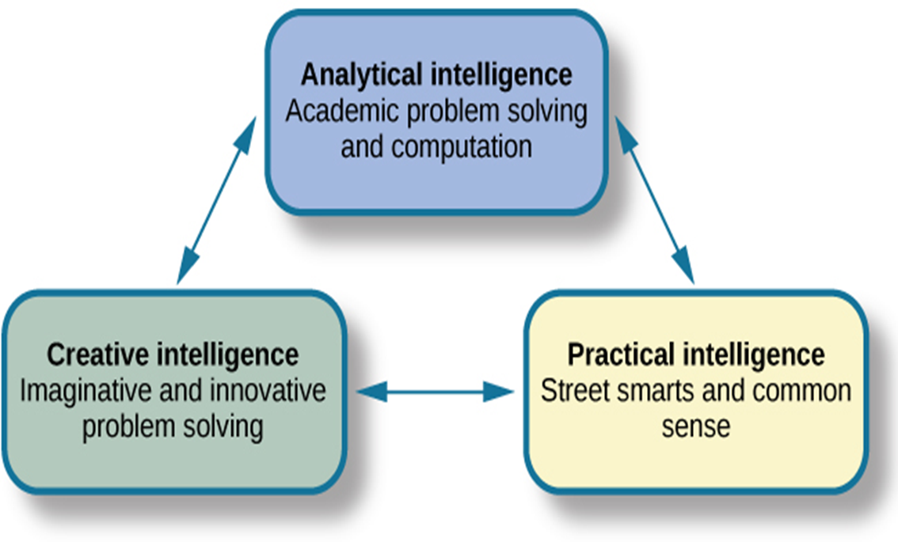
Theories of intelligence (cont.)
Sternberg’s Theory
  Three types of intelligences

Slide 8
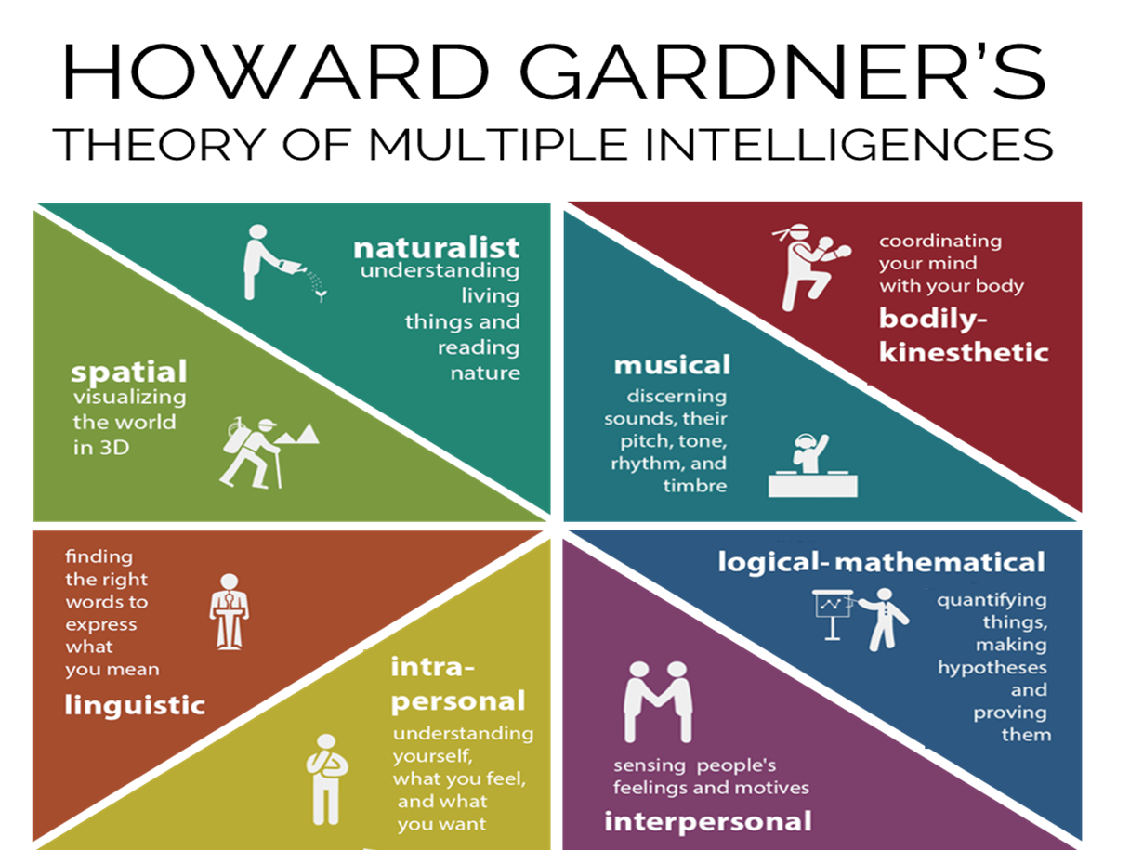
Theories of intelligence (cont.)
Gardner’s Theory
  Eight types of intelligences

Slide 9
INTELLIGENCE TESTING
  Standford-Binet test
  Wechsler tests
  Raven’s progressive matrices

Slide 10
The standford-binet test
In 1904, Binet and Simon were commissioned by the French government to devise a test which would identify those children who wouldn’t benefit from ordinary schooling because of their lower intelligence.
The result was the Simon–Binet test (1905), generally accepted as the first INDIVIDUAL intelligence test.
Revisions led to Standford-Binet test
1986 – 4th revision and 2003 – 5th edition
  Verbal and nonverbal scales are balanced (based on gf-gc theory)
  Mean 100, SD 15
  Verbal IQ, nonverbal IQ, full-scale IQ

Slide 11
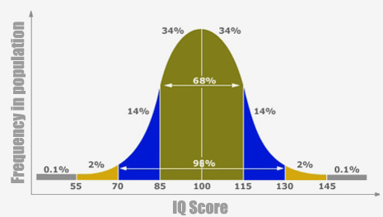

Slide 12
Army Alpha and Army Beta IQ Tests
These were the very first GROUP intelligence tests in history, developed in 1917–1919 by the U.S. Army to screen and classify over 1.7 million recruits during World War I.
Army Alpha - Designed for literate recruits (those who could read and write English well).
Army Beta - Designed for illiterate recruits or non-English speakers (mostly recent immigrants from Southern/Eastern Europe and some African Americans).

Slide 13
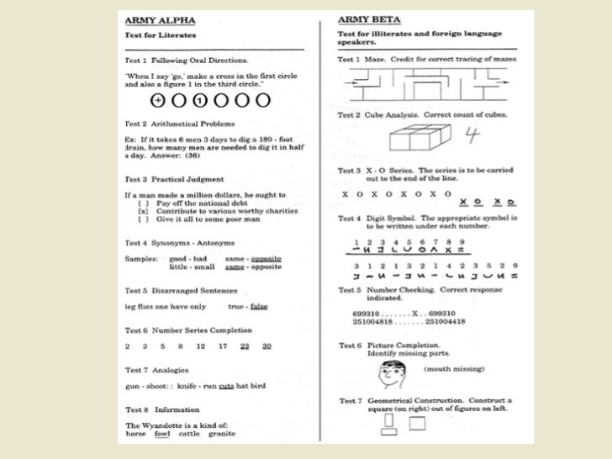

Slide 14
Wechsler tests
Balanced verbal and nonverbal scales
The most commonly used IQ tests globally
Most recent versions:
  Wechsler Preschool and Primary Scale of Intelligence (WPPSI – IV, 2012) – 2.5 – 6 yrs old
  Wechsler Intelligence Scale Children (WISC – V, 2014) – 6-16 yrs old
  Wechsler Adult Intelligence Scale (WAIS-V, 2024) – 16-90 yrs old

Slide 15
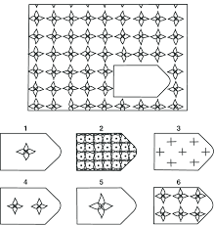
Raven’s progressive matrices
Raven’s Standard Progressive Matrices (SPM), Advanced Progressive Matrices (APM), and Colored Progressive Matrices (CPM for children) (Raven, 1938; 1998).
Non-verbal
Culture-reduced

Slide 16
Gender differences in iq - gender
Most IQ tests have been constructed so that there are no differences in scores between genders
Any difference between genders may only have been negligible (Terman, 1916)
Meta-analyses reporting scores for men average 5 IQ points more than women (Irwing & Lynn, 2005) have small effect sizes

Slide 17
Gender differences in iq
Males better on visuo-spatial tasks (e.g. mental rotation). Mean of male distribution on mental rotation is almost one standard deviation above that for females (Masters and Sanders, 1993)
  Constructing models, furniture assembly
Males also score higher on mechanical reasoning (e.g. Maintainig, repairing, operating equipment) and quantitative tasks (maths)
Females perform better than males on a number of verbal tasks, such as synonym generation, and verbal fluency. Mean of female distribution is between 0.5 and 1.2 standard deviations above that of males.
Females may also perform better than males on some memory tasks.

Slide 18
Why?
Biological:
Brain size: Males have ~10% larger brains on average, correlating with ~0.3-0.4 IQ points per gram
(though females have higher neuronal density).
Hormones: Prenatal testosterone exposure predicts better spatial skills and male-typical play;
estrogen supports verbal memory.
Evolution: Hunter-gatherer hypothesis posits male spatial edges from navigation/hunting;
female verbal from social/child-rearing roles (supported by cross-cultural consistency).
Environmental:
Socialization: Girls encouraged in language arts, boys in STEM toys (e.g., LEGO studies show early gaps).
Education: Gaps narrow in gender-equal societies (e.g., PISA data from Nordic countries), but high-end math differences persist.
Gender differentiated toys

Slide 19
Gender differences in iq - race
A number of studies (based in USA) have reported that some racial groups differ in intelligence
Jensen (1969) suggested that white children were more intelligent than black children, and Asian children were more intelligent than either. He claimed that such differences were largely due to genetic factors
Herrnstein and Murray published The Bell Curve (1994), suggesting a difference of one standard deviation between mean IQ scores of Blacks (mean = 85) and Whites (mean = 100) in USA
Herrnstein and Murray further suggested that the differences are genetic in origin

Slide 20
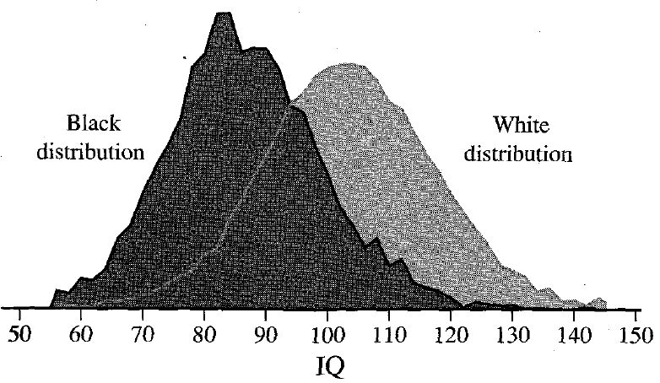
Gender differences in iq - race
American Psychological Association assembled a task force to investigate Herrnstein and Murray’s findings (see handout Neisser et al., 1996)
Task force agreed that there were differences between average IQ scores of African Americans and white Americans, but suggest that differences may be due to cultural factors.

Slide 21
why?
Three possible explanations for race difference on IQ scores
  Test bias
  Genetics
  Environment

Slide 22
Test bias
This explanation posits that IQ tests are not neutral but reflect the cultural knowledge, language, and experiences of the dominant group (typically White, middle-class Americans), disadvantaging minority groups. Differences in scores, therefore, do not measure true intelligence but familiarity with test content.

Slide 23
genetics
This view argues that racial groups have evolved genetic differences in cognitive abilities due to historical selection pressures (e.g., climate, migration), leading to inherent IQ disparities
Race is primarily a social construct, not a biological one; No genes for "intelligence" have been identified that differ systematically by race.
Nisbett, R. E., et al. (2012). "Intelligence: New findings and theoretical developments." American Psychologist, 67(6), 503–504.

Slide 24
environment
This dominant explanation attributes gaps to unequal access to resources, education, health, and opportunity, which shape cognitive development from prenatal stages onward. Racial categories proxy for systemic inequities (e.g., racism, poverty).
While all three explanations have been proposed, the overwhelming scientific consensus is that environmental factors, compounded by historical and ongoing inequities, account for nearly all racial IQ differences.

Slide 25
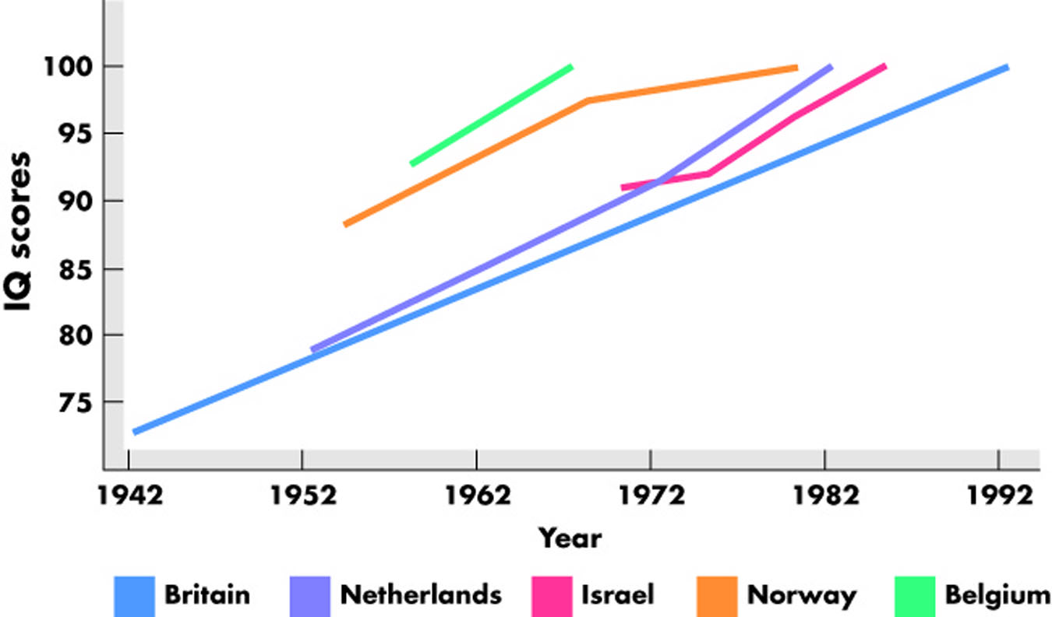
The Flynn effect
IQ has increased over time, on average around 3 IQ points per decade
Largest gains in fluid intelligence (reasoning, pattern recognition—e.g., Raven’s Matrices), not crystallized (vocabulary, facts).
Observed in >30 countries, including developing nations.
Slowing or reversing in some developed nations (Norway, Denmark, UK) since the late 1990s.

Slide 26
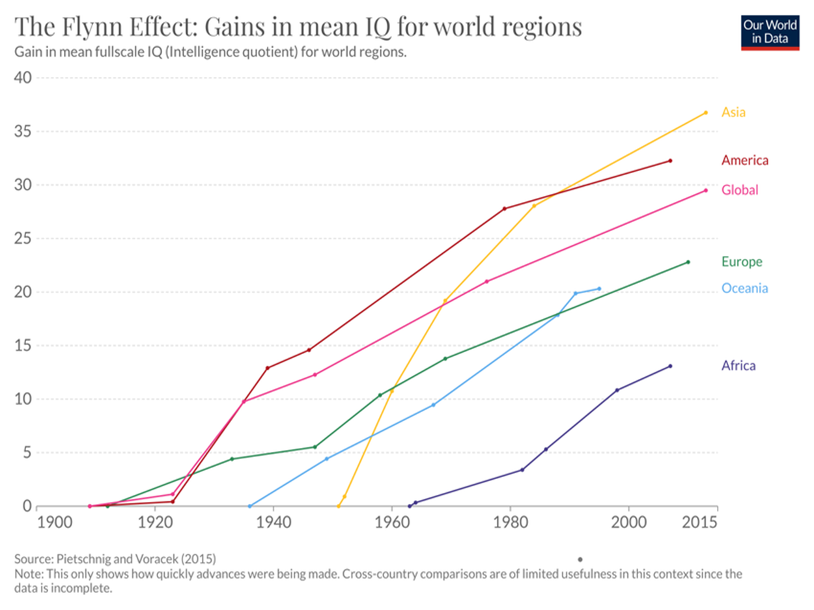

Slide 27
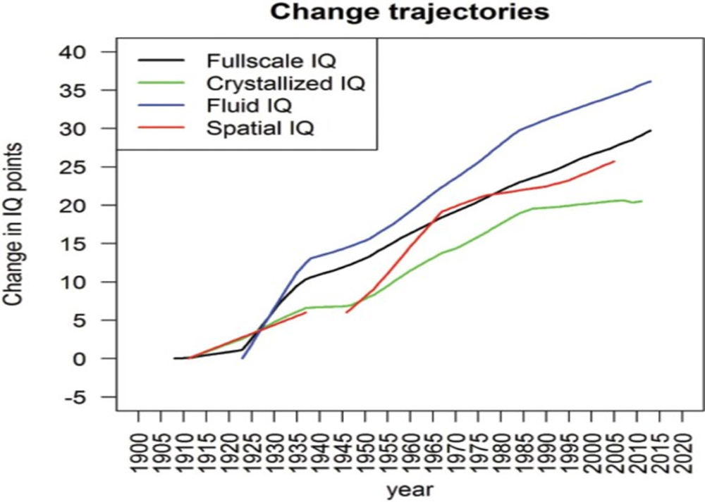

Slide 28
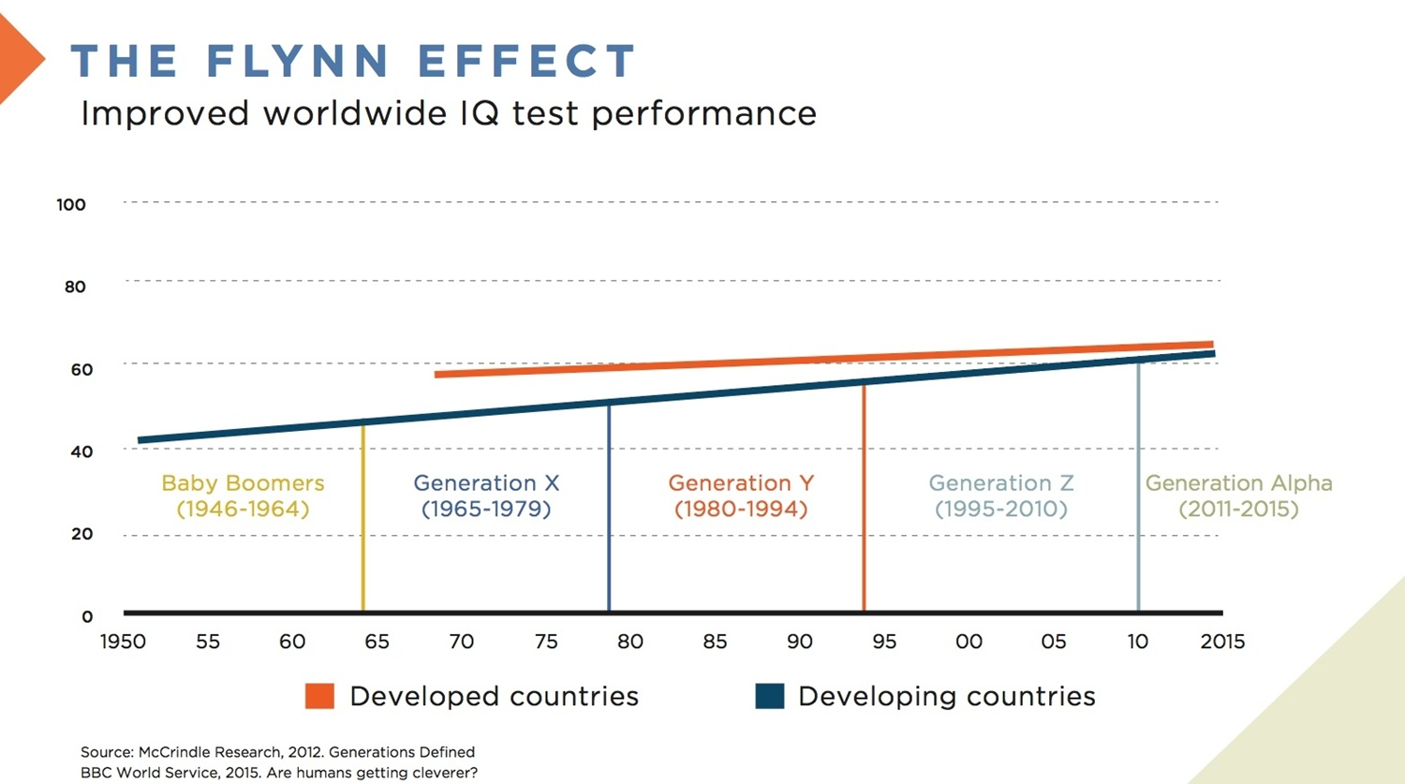

Slide 29
Why?
Nutrition: Better prenatal and childhood nutrition → brain growth
Education: Longer schooling, abstract thinking training
Cognitive Stimulation: TV, puzzles, video games, VR
Smaller families: More parental attention per child
Test familiarity: Practice with multiple-choice, abstract problems

Slide 30
Heredity or environment?
Both heredity and environment contribute to intelligence
Heredity and environment interact in various ways
As people’s genetic similarity increases, generally so does the similarity of their environments. This can be overcome by comparing the IQs of Monozygotics reared together with those raised apart.
MZsRA are still more similar than same-sex Dizygotics reared together, suggesting a strong genetic influence.
  However, studies of MZsRA have been criticized on several important methodological grounds.
Further support for the influence of genetic factors comes from adoption studies. But when children from disadvantaged parents are adopted into high SES families, substantial gains in IQ can occur.

Slide 32
Lecture summary
Definition of intelligence
Theories of intelligence
  Two-factor theory of Spearman
  Fluid and Crystallized Intelligence theory of Cattell
  Sternberg’s theory
  Gardner’s theory
Intelligence testing
  Standford-Binet test - first IQ test
  Wechsler tests - most widely used IQ test
Gender differences in IQ
Racial differences in IQ
The Flynn Effect

